Slide 1

Quantum Computing
Quantum Algorithm For Estimating The Determinant.
For QCourse110-1 Project
Presented by
Yassin Khaled Ibrahim
CCE’28 Alexandria University.

Slide 2

Topics
1- Overview on Giovannetti, Lloyd, and Maccone Paper + Overview of Qiskit Implementation Notebook
2- News : QSP from Microsoft
3- Private Company : CryptoNext-Security
4- Resources

Slide 3
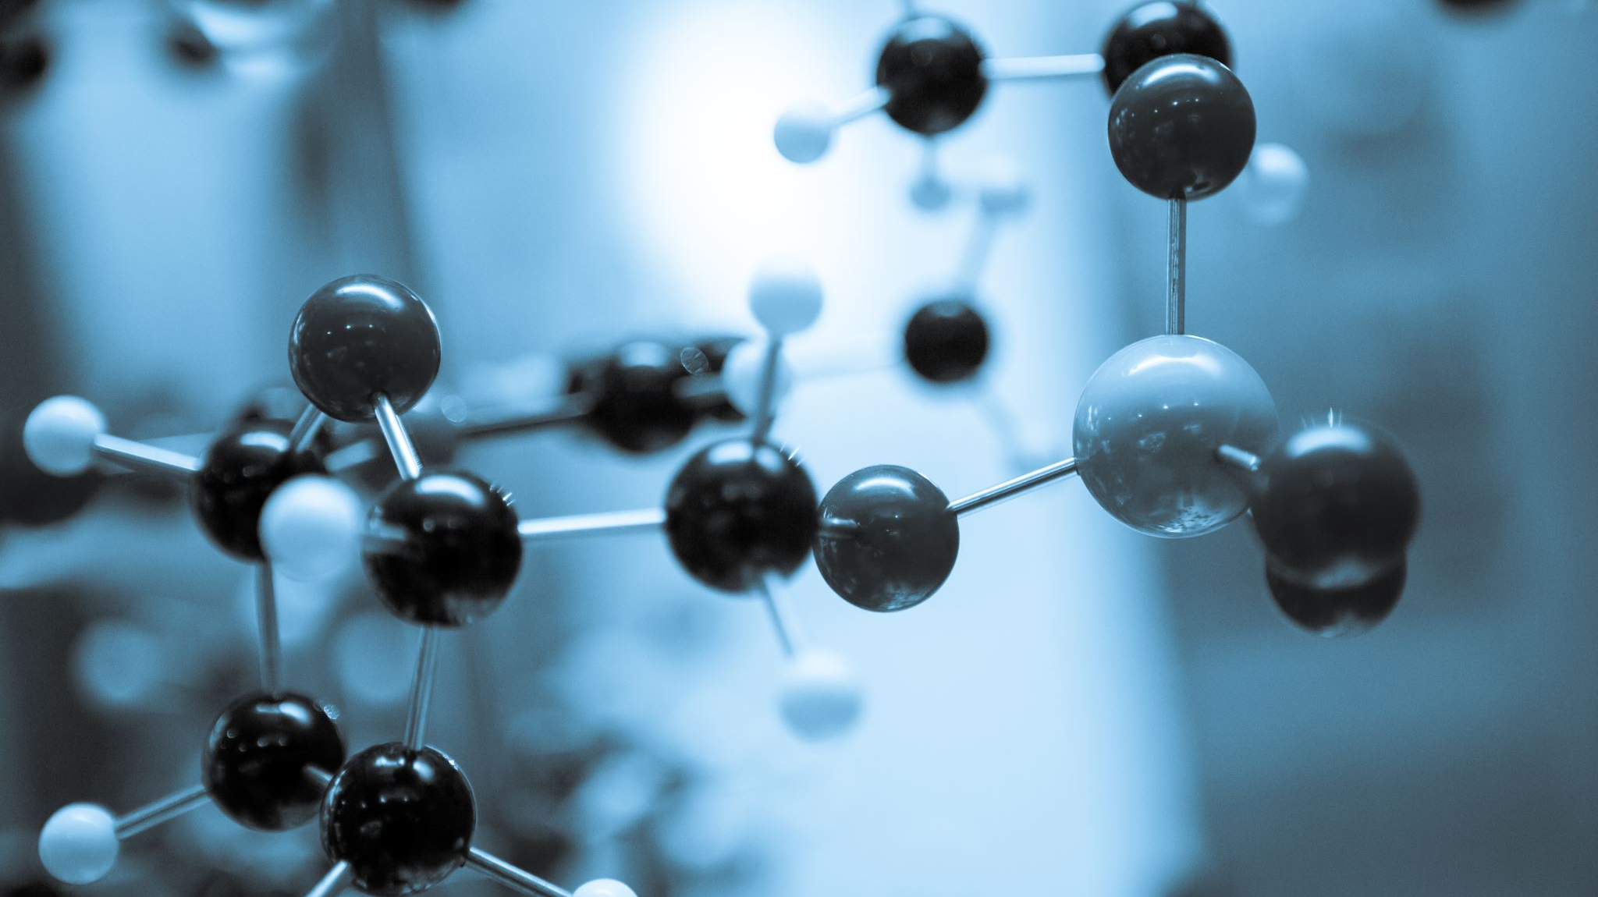
1. Quantum Algorithm For Estimating Matrix Determinants
This research was published in May 2025 by three leading quantum computing researchers. Vittorio Giovannetti(MIT), is an expert in quantum information theory, Seth Lloyd(MIT), is a pioneer in quantum algorithms and quantum machine learning, and Lorenzo Maccone(University of Pavia) specializes in quantum information processing. Together, they developed this quantum algorithm that achieves exponential speedup for matrix determinant estimation, representing a significant breakthrough in quantum linear algebra with immediate application
→ Problem : Calculating determinants of large matrices.
→ Why is this Algorithm important?
  Essential for machine learning, data analysis, and physics simulations
  For large sparse matrices, becomes computationally prohibitive

Slide 4
1.1- Performance Comparison
Method | Computational Complexity (Using O Notation) | Scaling
Classical Algorithms | O(n) | Linear in matrix size
Quantum Algorithms | O(log n / ε³) | Logarithmic
Table 1.1
As Shown in Table 1.1, Classical algorithms Scale linearly with matrix size (O(n)) ,While Quantum algorithm Scales logarithmically (O(log n/ε³)), The complete complexity is O(κ(log κ)²s²/ε³ log n log²(s²/ε)), where κ is the condition number and s is the matrix sparsity, Classically O(n³). This logarithmic scaling represents a fundamental breakthrough - for a matrix of size n=10⁶, classical methods require roughly one million operations, while the quantum algorithm needs only about 20 operations (plus logarithmic factors). and that's exponentially faster by far!!

Slide 5
1.2- Difficulties
1- Theoretical Limitations
    No-Cloning Theorem: Can't copy quantum states for error checking
    Measurement Destruction: Each measurement destroys the quantum state, requiring restart
    Probabilistic Nature: Results are inherently statistical, never providing exact answers
2- Quantum Hardware Limitations
    Quantum RAM Requirement: The algorithm assumes efficient quantum random access memory, which doesn't exist yet
    Hamiltonian Simulation: Implementing e^(-iAt) for arbitrary sparse matrices is computationally expensive, where A is the Matrix
    Quantum Error Correction: Requires thousands of physical qubits to create one logical qubit, making large-scale implementation impractical

Slide 6
1.3- Implementation Using Qiskit
The quantum determinant estimation algorithm was implemented Qiskit through a ‘QuantumDeterminantEstimator’ class. The implementation automatically preprocesses matrices to ensure positive definiteness, calculates theoretical parameters (μ, Δ, κ) from eigenvalues, and constructs quantum phase estimation circuits with precision and system registers. Controlled-phase gates encode eigenvalue information as quantum phases, followed by inverse quantum Fourier transform and measurement. The system processes measurement bitstrings to extract eigenvalue samples, applies Monte Carlo estimation using the formula α_est = (n/N_mc) × Σlog(λₓ), and includes adaptive parameter adjustment based on empirical quantum sampling results as specified in the paper's Appendix D.

Slide 7
2- Quantum-Safe Security Progress (QSP)
Microsoft is proactively leading the transition to quantum-safe security by advancing post-quantum cryptography, collaborating with global standards bodies, and helping organizations prepare for the coming quantum era. The company recognizes that while scalable quantum computing, still not available at the moment, could break current public-key cryptography methods, the time to prepare is now.
Microsoft is partnering with regulatory and technical bodies like the National Institute of Standards and Technology (NIST), Internet Engineering Task Force (IETF), International Organization for Standardization (ISO), Distributed Management Task Force (DMTF), Open Compute Project (OCP), and European Telecommunications Standards Institute (ETSI) to align on quantum-safe encryption standards and support worldwide interoperability.

Slide 8
2.1- Opportunities and Challenges Ahead
→Opportunities
  Lead in next-gen security with early PQC adoption
  Strengthen trust and regulatory readiness (by Partnering Up)
  Build crypto-agile systems for long-term resilience
  Collaborate with global standards and open-source efforts
→Challenges
  Performance and integration issues with legacy systems
  Evolving PQC standards and algorithm uncertainty
  High migration and operational complexity
PQC: post quantum cryptography

Slide 9
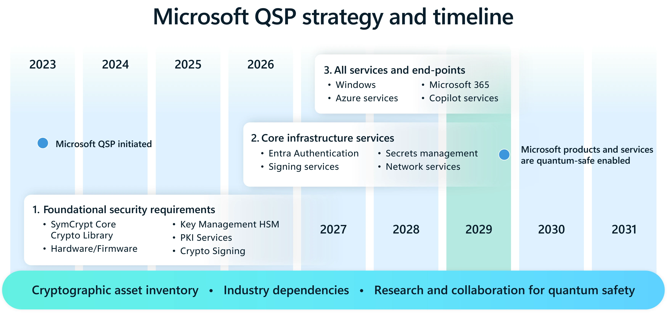
2.2-Strategy and Timeline
Fig 2.2

Slide 10
3- CryptoNext-Security
It’s a private company , founded in 2019 by Jean-Charles Faugère(Co‑Founder & CTO) and Ludovic Perret(Co‑Founder). In 2021, Florent Grosmaitre joined the team and became CEO. Company is Based in Paris, France. Company focuses on PQC as it’s a real, near-term threat
Purpose Of The Company
  To protect organizations from the quantum computing threat by enabling cryptographic systems to be post‑quantum secure and crypto‑agile.
  They offer tools for assessing, migrating, managing cryptography so that infrastructures, communications, and data remain secure even after quantum computers capable of breaking today's public key systems exist.
  They are offering not just research, but deployed solutions.
  The fact that they have achieved NIST CAVP certifications for all three PQC standardized algorithms gives them credibility.

Slide 11
3.1- Future Vision
Industrialization of their Remediation Solutions
International Expansion
Crypto‑Agility as a Core Value
Customer‑driven Use‑Case Expansion
Controlled Cost & Practical Migration Paths
Thought Leadership & Regulatory Influence

Slide 12
4-Resoucrces
Research Paper from ArXiv : [2504.11049] A quantum algorithm for estimating the determinant
Table 1.1 from Paper Analysis
I used Symbol Lab to check the determent values in classical methods : Matrix Determinant Calculator - Free Online Calculator With Steps & Examples
QFT studied from
  QFT (latest version) | IBM Quantum Documentation
  Circuit for the inverse quantum Fourier transform • Physics Forums
News From Microsoft : Quantum-safe security: Progress towards next-generation cryptography | Microsoft Security Blog
Company from : Cryptographic Risk Management in the Post-Quantum Era
Fig 2.2 : QSP-Roadmap.webp (3498×1650)

Slide 13
Thank You !

